Slide 1
Deforestation and Climate Change (case of Zambia)
Hadunka, Protensia; Sellars, Sarah C; Liu, Menglin; and Yamasaki, Yoko
Notes:
Each slide takes 1 or 2 mins

Slide 2
Motivation
Deforestation particularly in Sub-Sahara Africa (SSA) has been on the rise which threatens the global climate and also bio-diversity (Sparovek et al., 2012).
Trees are an integral for food, fuel, medicinal products, building materials, and as a commodity in this region (Boffa, 1999)
Rural smallholder farmers in Zambia rely on trees as an important source of income from charcoal production (Mulenga, Hadunka, and Richardson, 2017)
Climate change and deforestation have impacts not only for local people and small farmers, but this relationship is understudied.
Notes:
Sarah

Slide 3
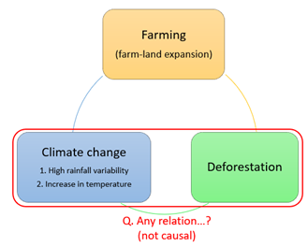
Research questions
Is there a relationship between the deforestation rate and climate change in Sub-Saharan Africa?
Notes:
Sarah

Slide 4
Data
Unit of analysis: Household (1400 HHs)
Household Income Consumption and Production Survey (HICPS)
Geocodes & Cultivated land areas
Outcome: Temperature
Moderate Resolution Imaging Spectroradiometer (CHIRPS)
Treatment: Deforestation rate from Global Forest Change dataset
Controls: Rainfall from Climate Hazards center InfraRed Precipitation with Station data (MODIS)
Years under study: 2015-2019
Notes:
Sarah

Slide 5
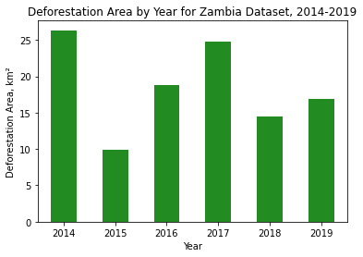
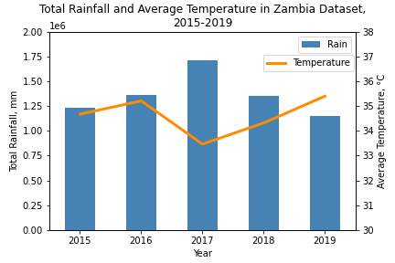
Data - Graphs
Notes:
?

Slide 6
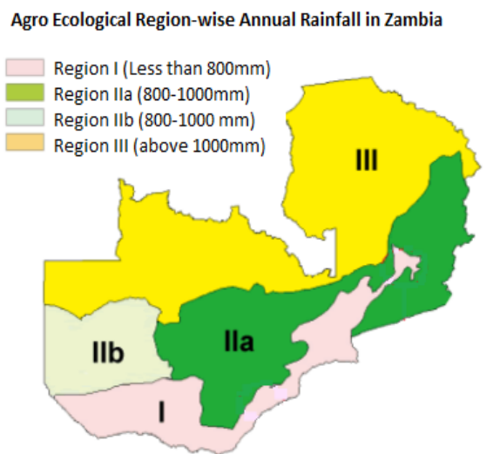
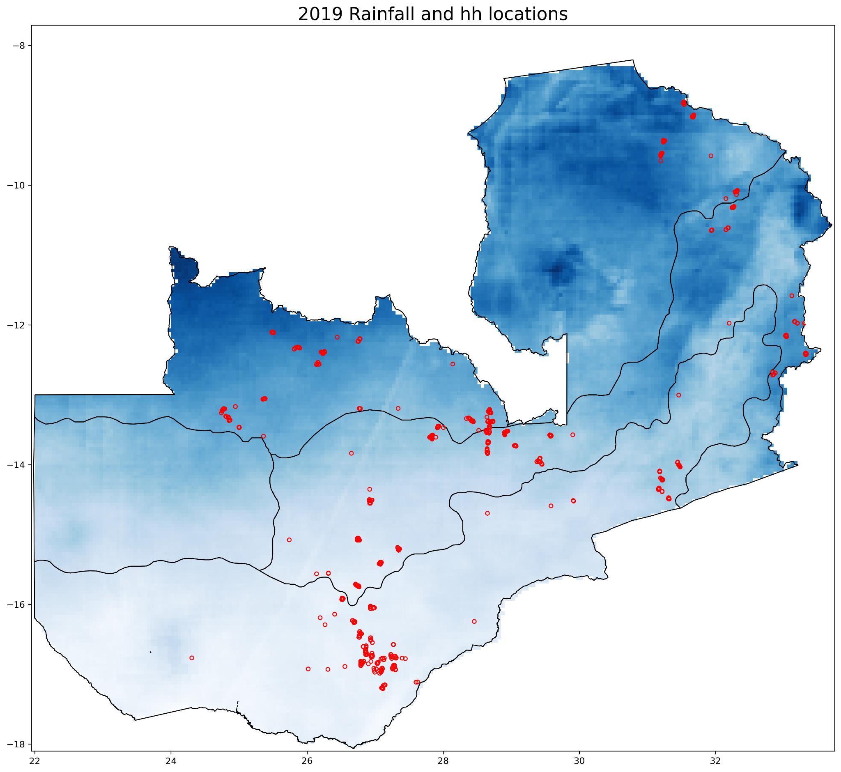
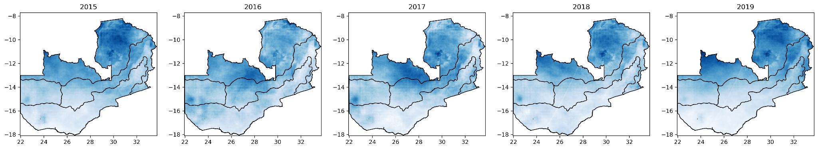
Data - visualizations
Source: https://www.climateinvestmentfunds.org/sites/cif_enc/files/IFC_PPCR_Zambia_Weather%20Index%20Insurance_Public_Short_English_23Feb2014.pdf
Notes:
?

Slide 7
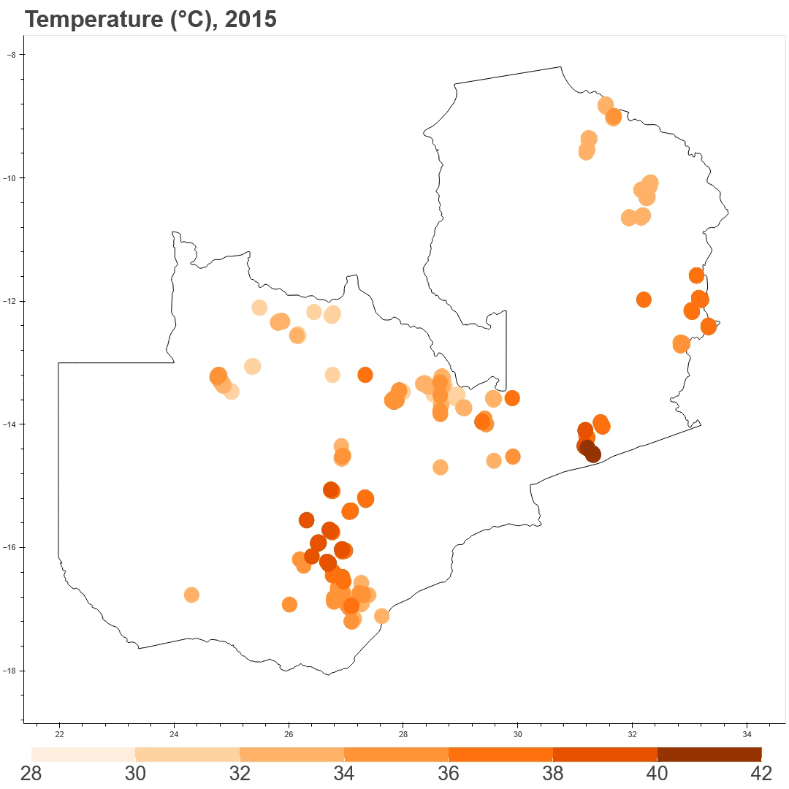
Temperature from 2015 - 2019

Slide 8
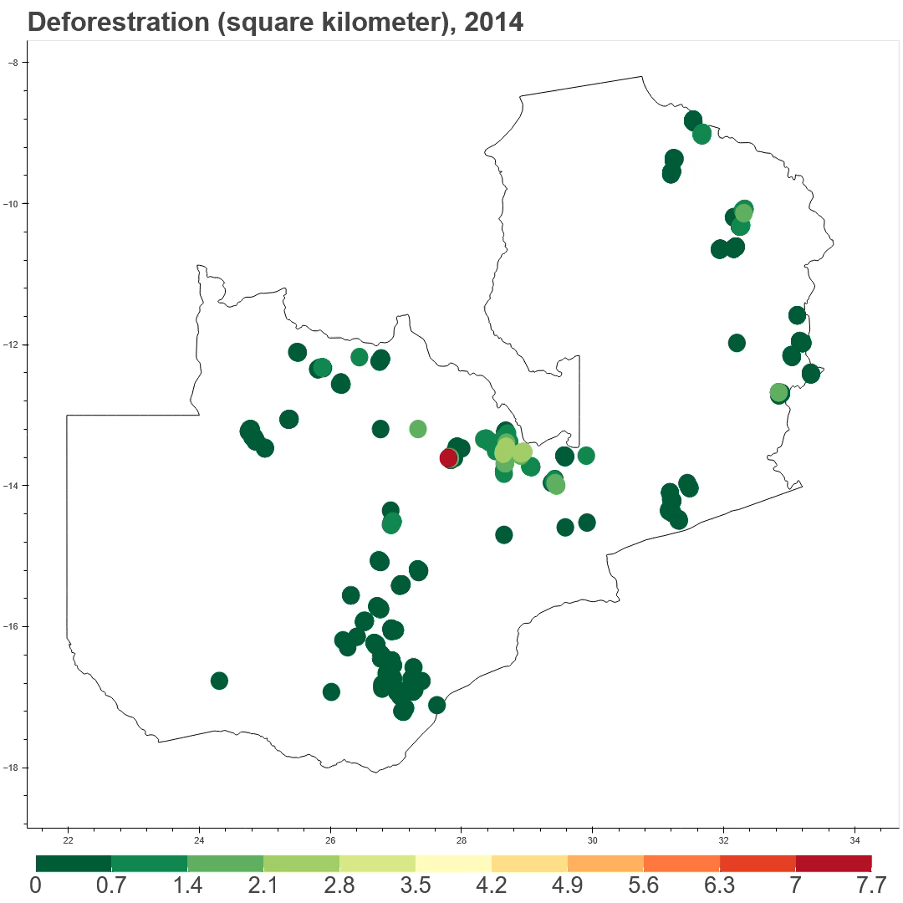
Deforestation from 2014 - 2018

Slide 9
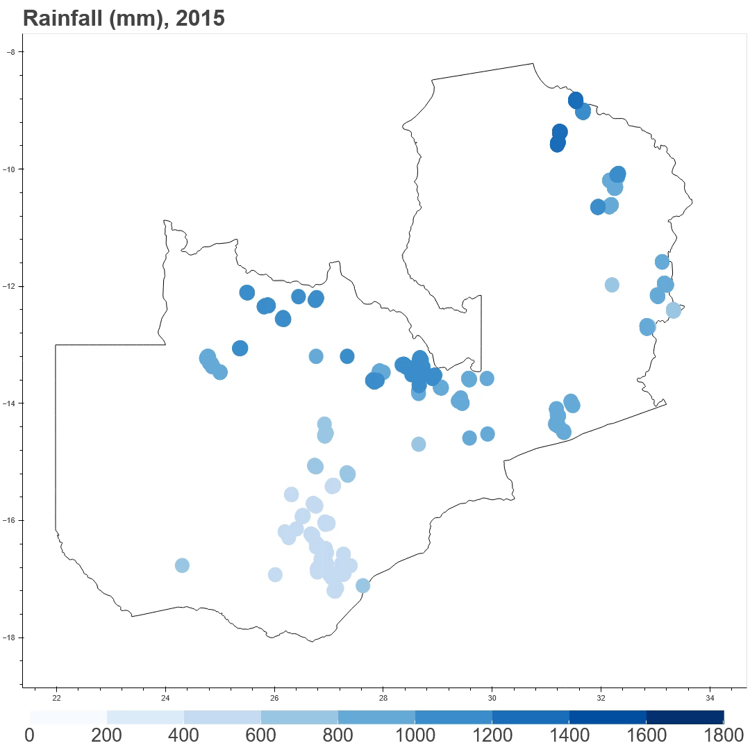
Rainfall from 2015 - 2019

Slide 10
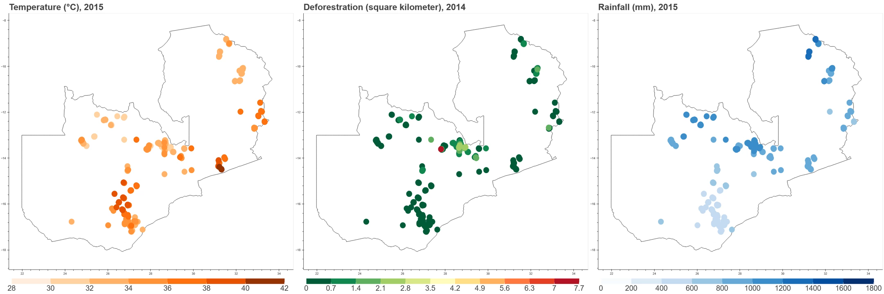

Slide 11
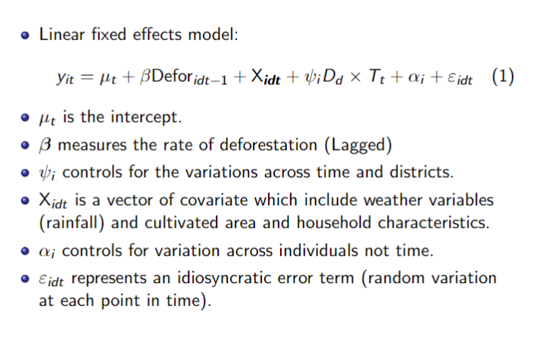
Analysis - Methods
Notes:
Protensia

Slide 12
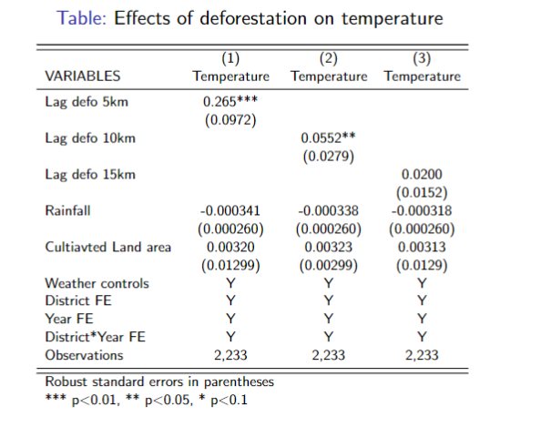
Analysis - simple regression
Notes:
Protensia

Slide 13
Conclusion
Our results shed new light on the discussion on climate change.
The focus should not just be on emissions and climate change.
We find a strong correlation between climate change and deforestation.
Policy makers must focus on interventions that decrease the rates of deforestation.
Notes:
Protensia

Slide 14
References
Boffa, 1999. https://www.fao.org/3/X3940E/X3940E00.htm#TOC
Mulenga, Hadunka, and Richardson, 2017. https://www-nowpublishers-com.proxy2.library.illinois.edu/article/Details/JFE-0331

Slide 15
Appendix

Slide 16
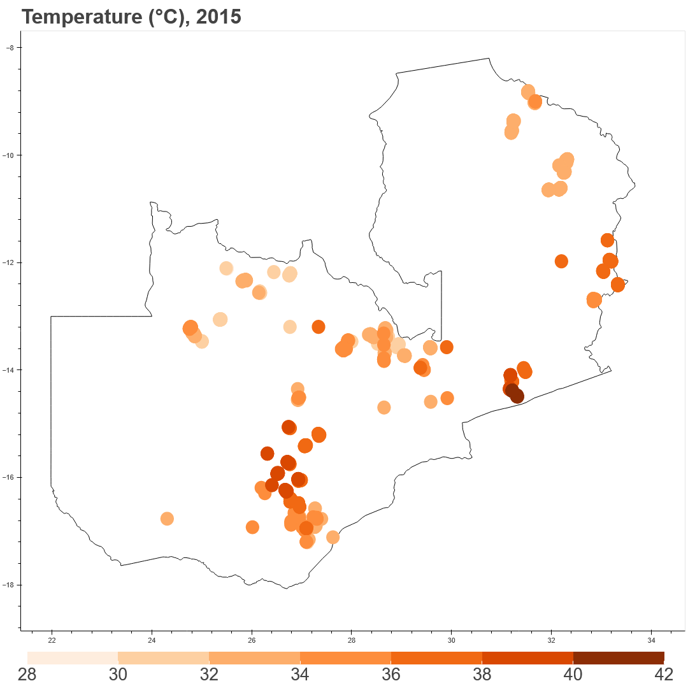

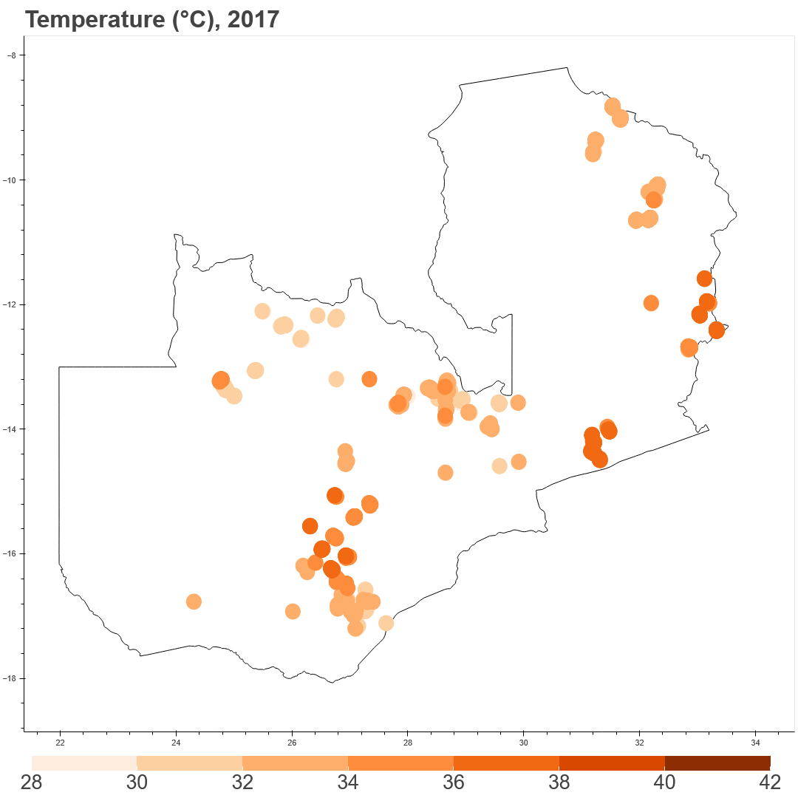
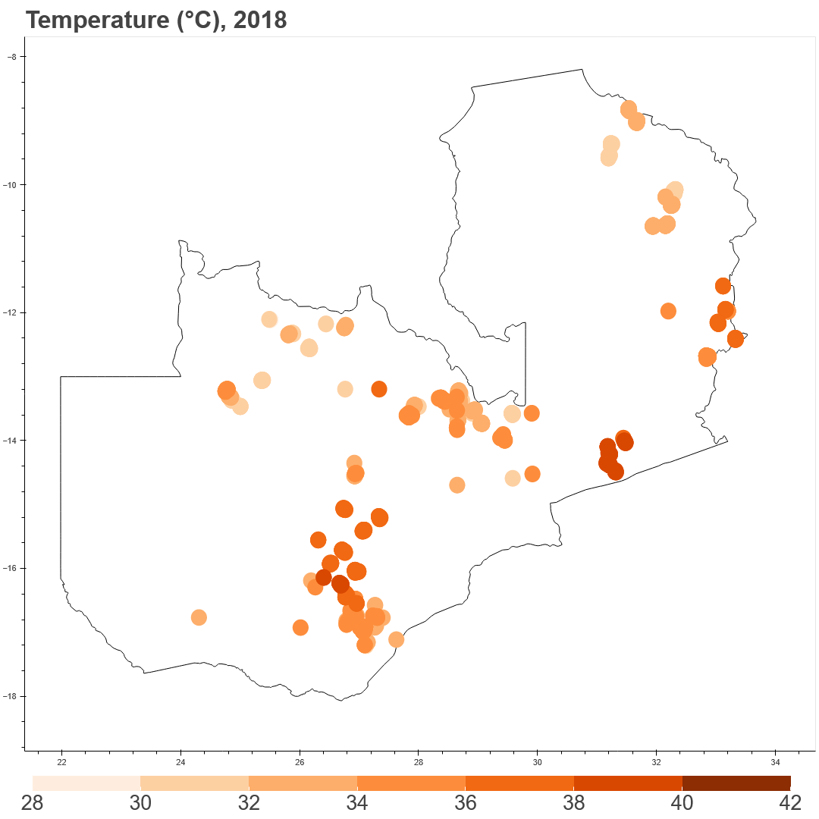
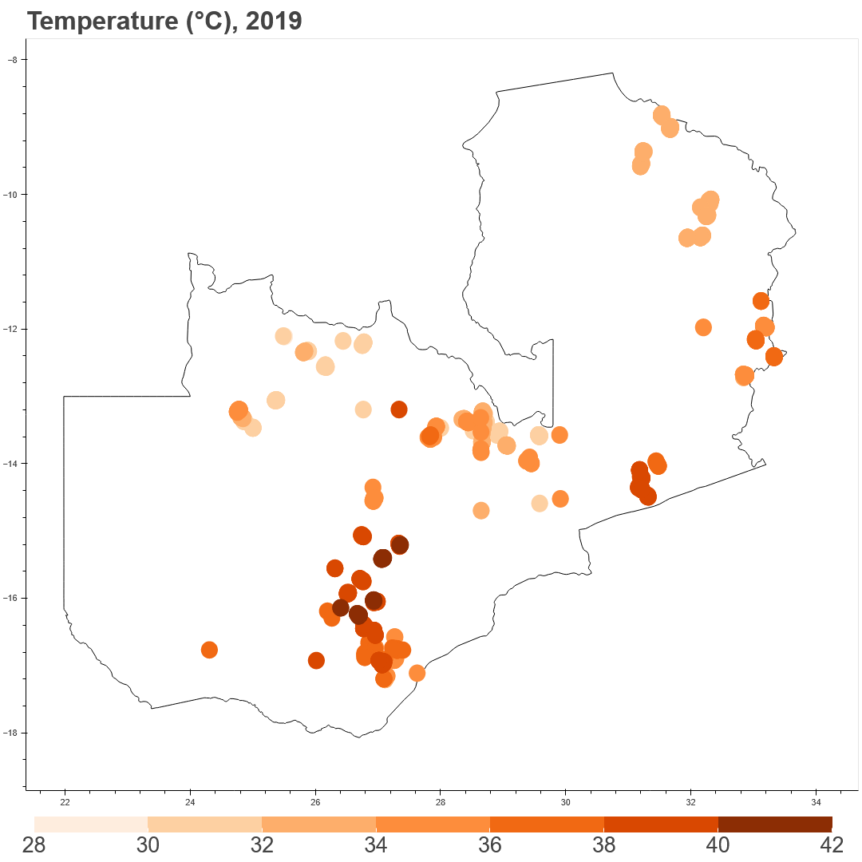

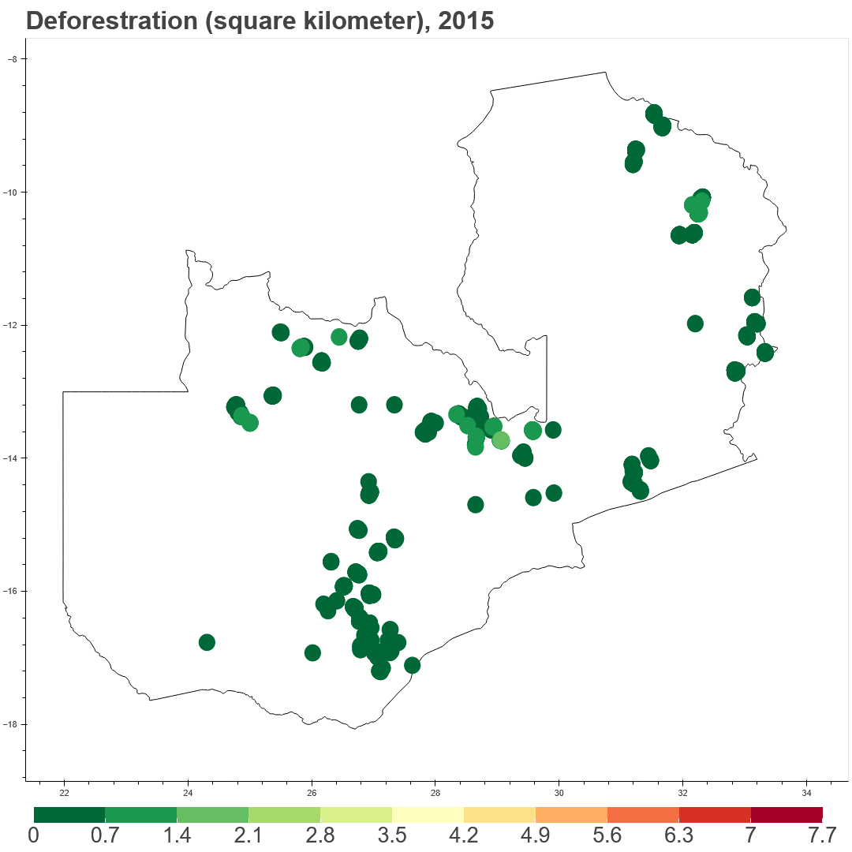




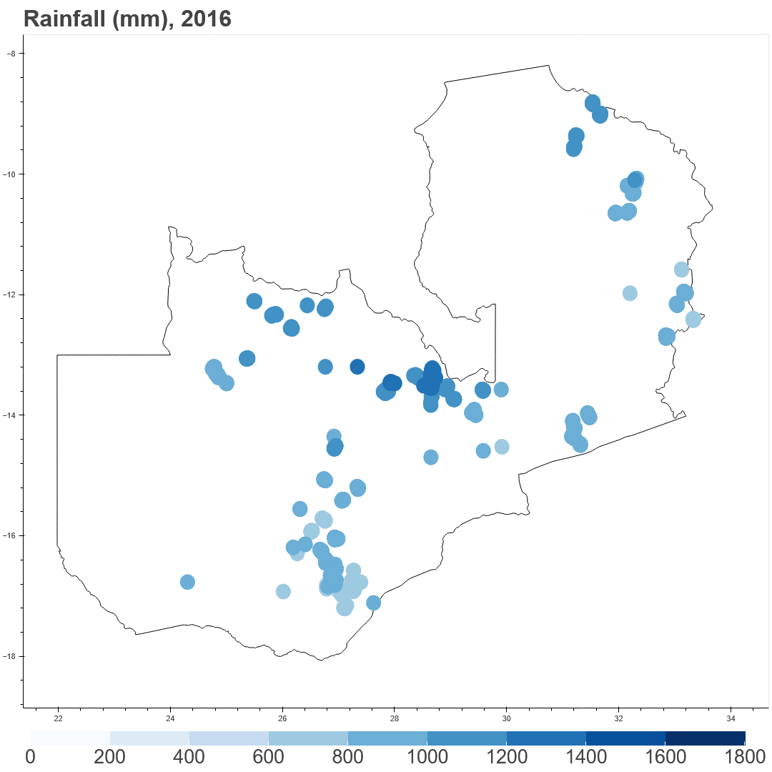
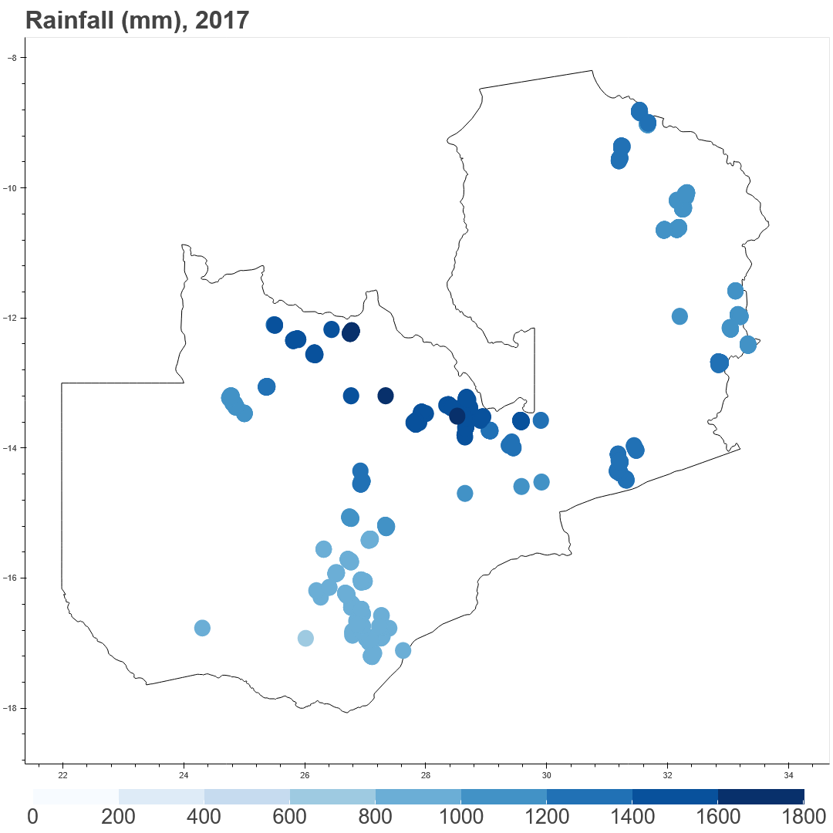
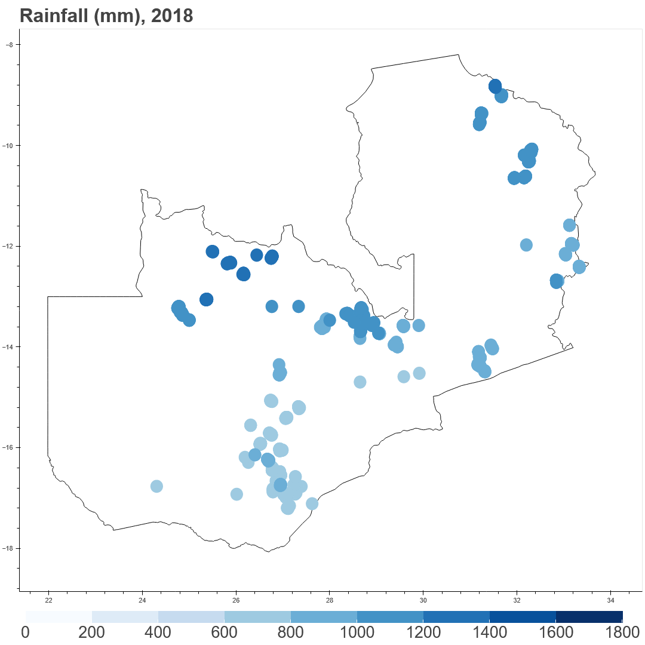
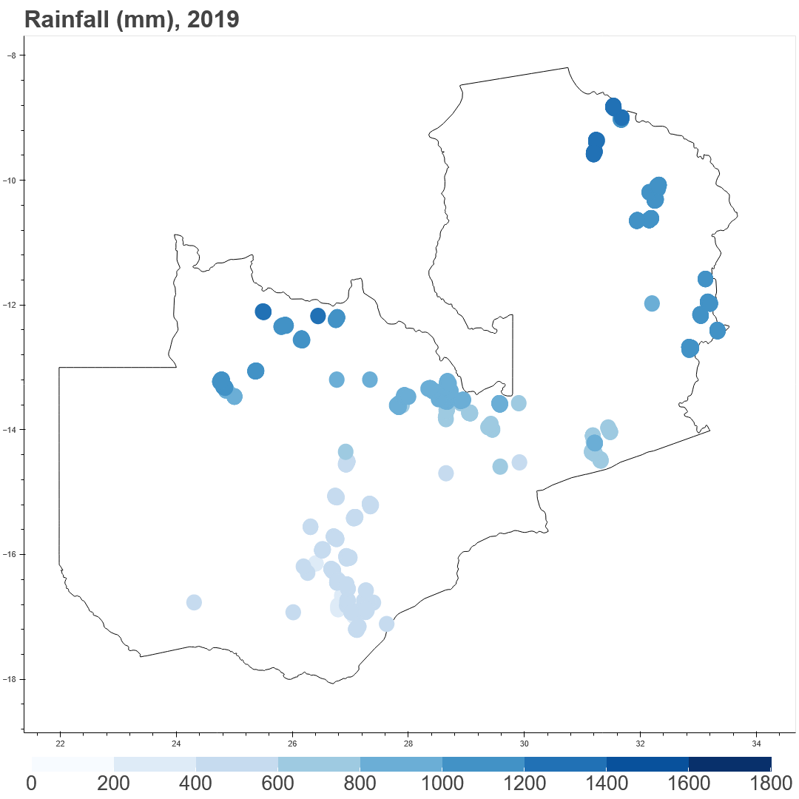
temperature
deforestration
rainfall
Notes:
?

